Slide 1

CHRISTUS Health
Monthly Status- monthyear

Slide 2
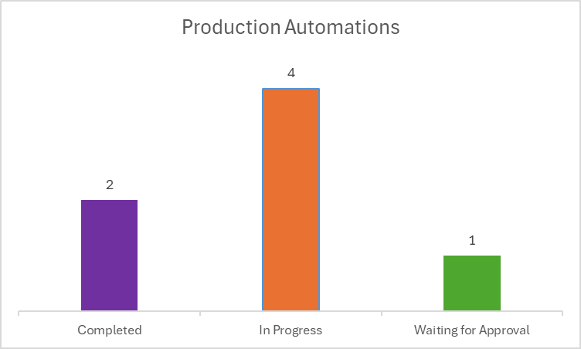
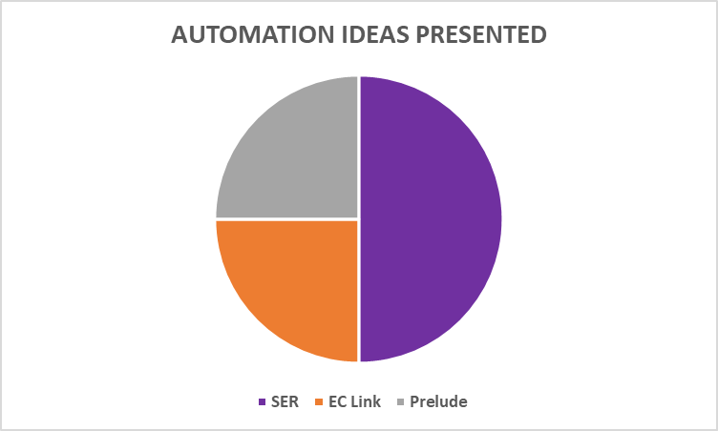
Test Automation
Key Achievements
Goals- nextMY
Scope
Monitor
Collaborate
Tracking
Note: The data reflects the status per the month of August, considering modules involved

Slide 3
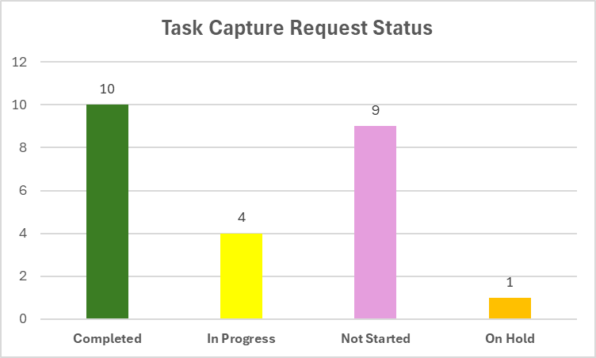
Quality Assurance
Key Achievements
Goals for nextMY
Task Capture Script Review
Task Capture
Task Capture Script update
Triple Upgrade Testing
Task Capture
Total:
Completed:
In Progress:
Not Started:
Module in numbers
Short Scripts Review
Automation Collaboration
Link to QA interactive Dashboard: Power BI Report for QA

Slide 4
EC-DC
Key Achievements
Module in numbers
Solution & Delivery
Provider on the Fly (POTF) Cleanup:
POTF CSV Cleanup:
Executed Daily DC Provider Report:
Managed CMT Reports and Conducted Standards Audits:
Resolved DC Migration SNOW Requests:
Performed Quality Assurance for EHR Sub CAB and Peer Review Meetings:
Solution & Delivery
Implementations
Scope of work
Goals for nextMY
CIRT Documents Review:​
Duplicate Provider Cleanup:

